Slide 1
Zachman Framework

Slide 2
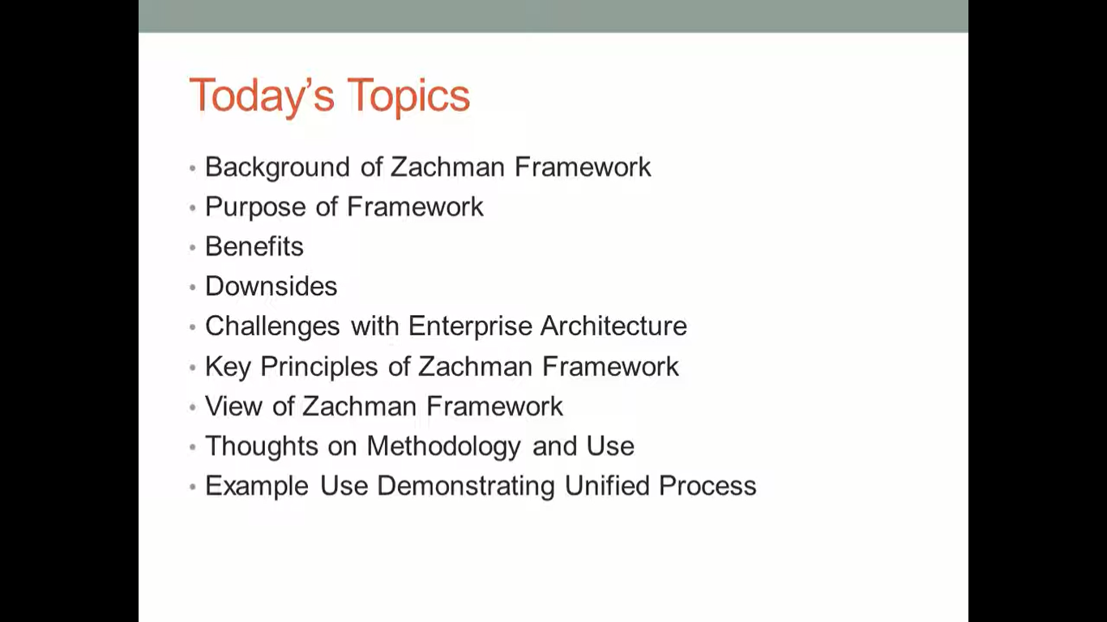

Slide 3
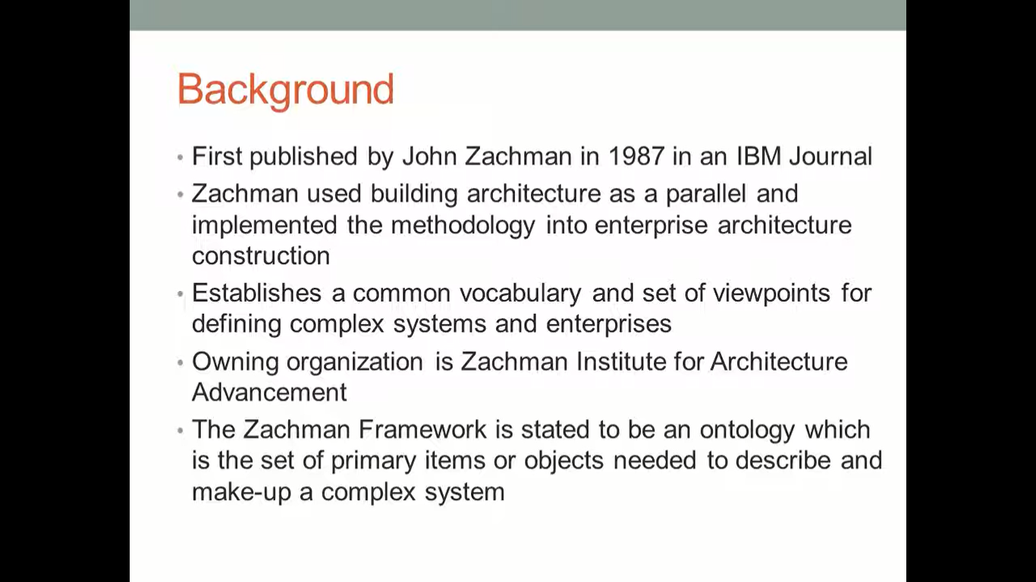

Slide 4
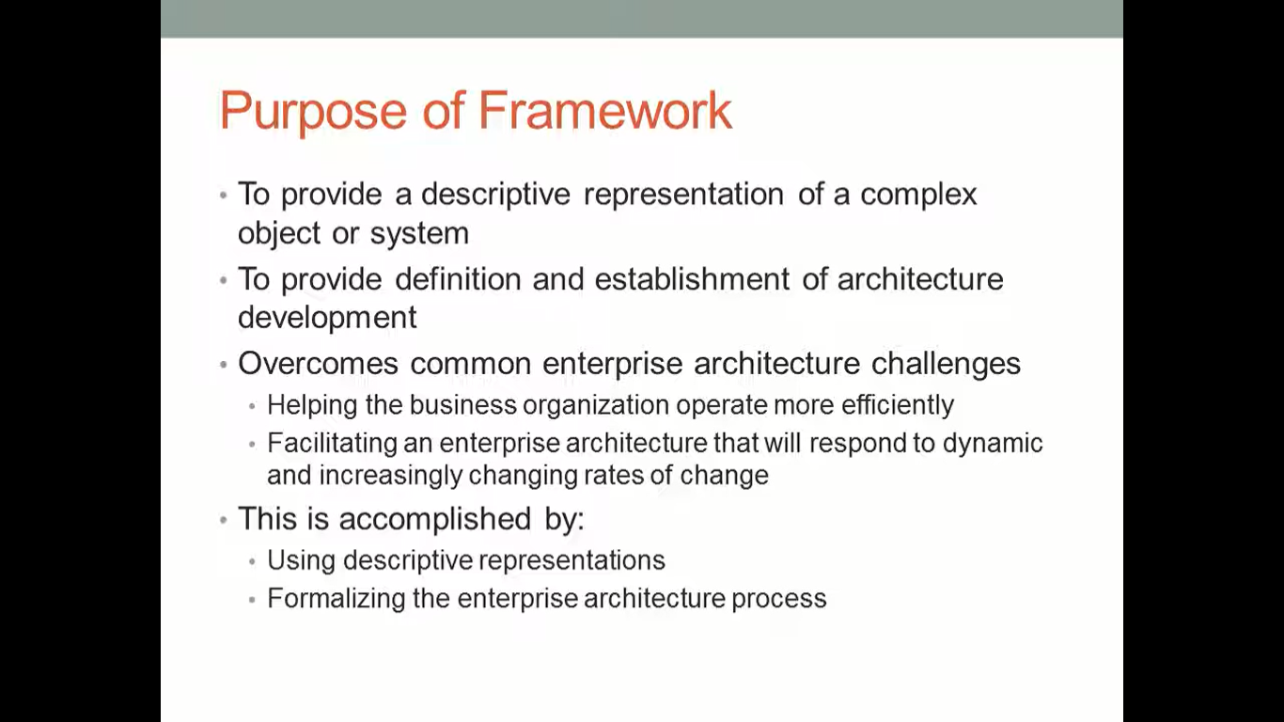

Slide 5
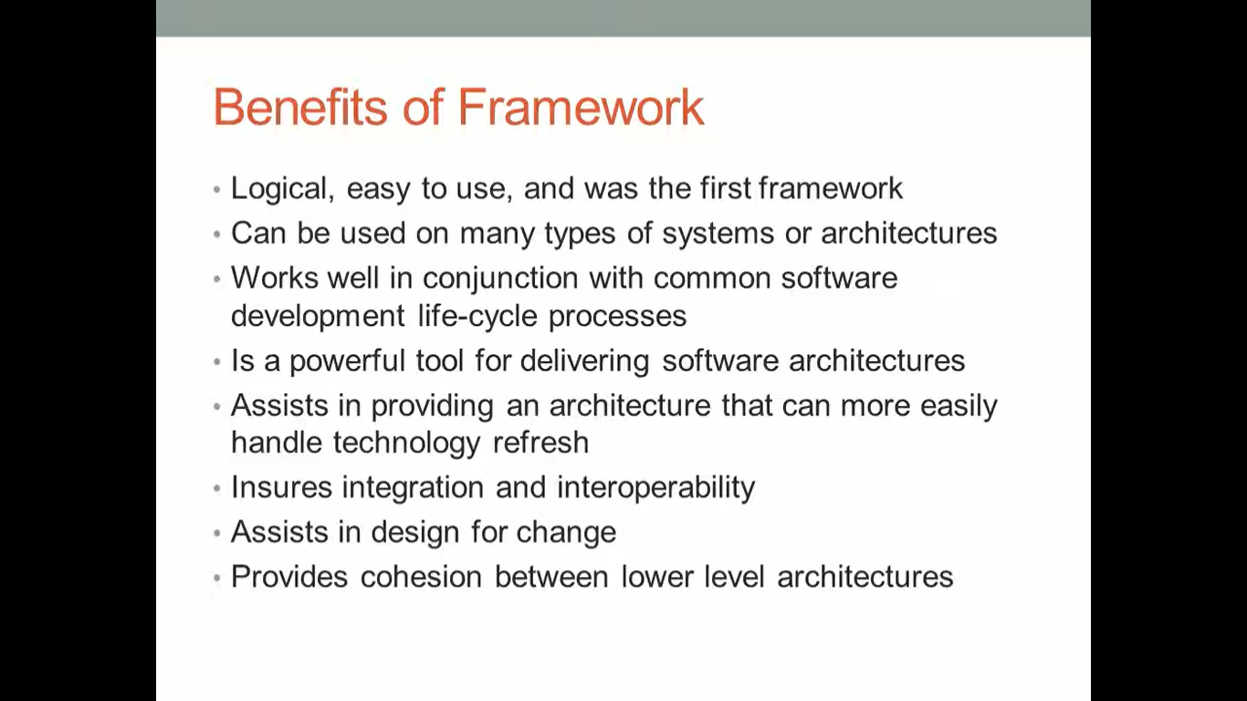

Slide 6
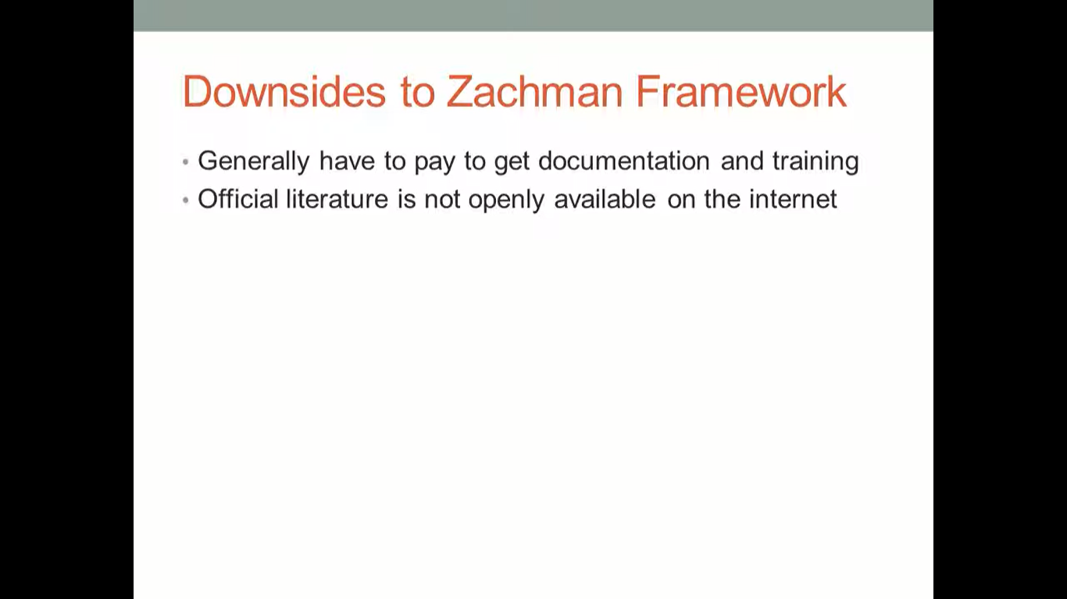

Slide 7
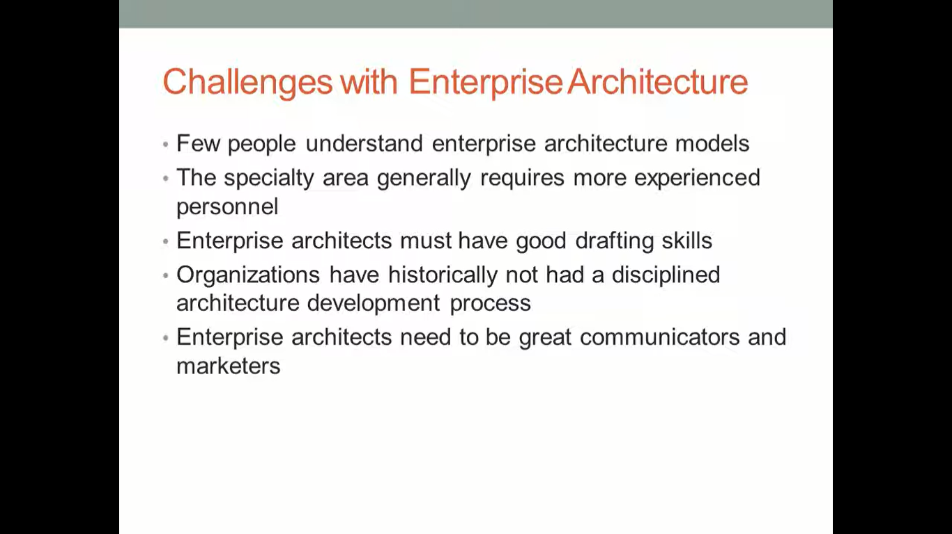

Slide 8
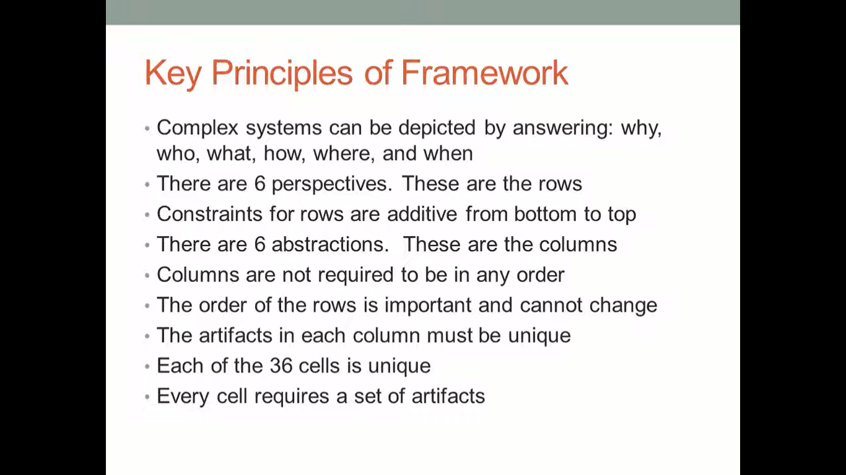

Slide 9
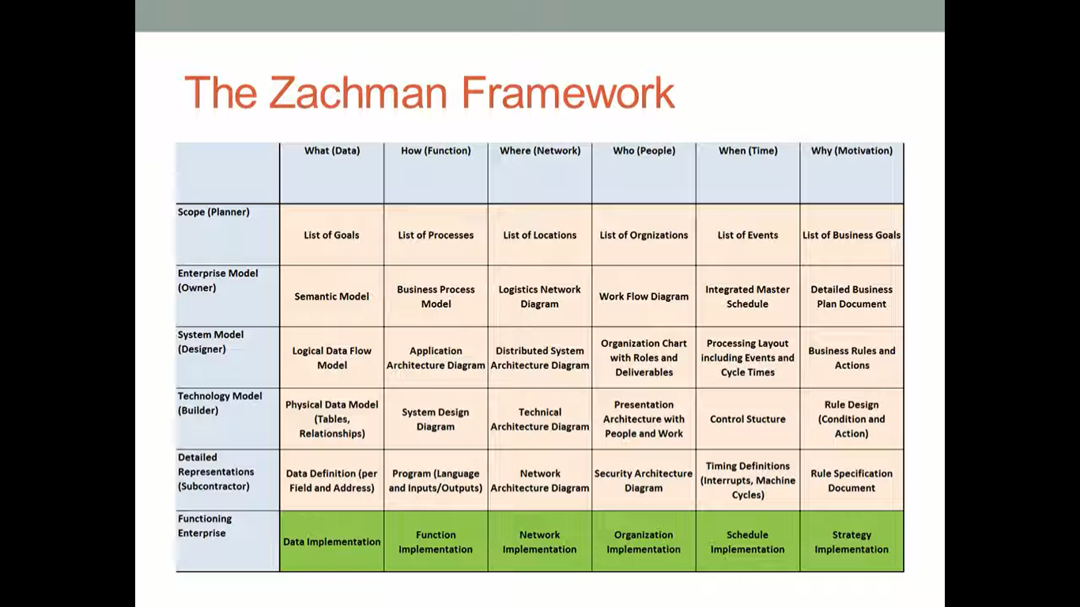

Slide 10
The Zachman Framework is a widely used framework for organizing and classifying the artifacts of an enterprise architecture (EA). The framework consists of a matrix that defines six dimensions of an enterprise: who, what, where, when, why, and how. Each dimension is further divided into a number of categories or cells, which represent different types of artifacts that might be created as part of an EA.
The Zachman Framework is often used as a tool for planning and managing the development of an EA, as it provides a structured way to identify and classify the various components that make up an enterprise. It is also useful for communicating the EA to different stakeholders, as it provides a common language and structure for discussing the various aspects of the enterprise.

Slide 11
Here is a brief overview of the six dimensions of the Zachman Framework:
Who: This dimension refers to the actors or stakeholders in the enterprise, such as customers, employees, and partners.
What: This dimension refers to the products, services, or systems that are part of the enterprise.
Where: This dimension refers to the physical locations where the enterprise operates.
When: This dimension refers to the timing and sequencing of events within the enterprise.
Why: This dimension refers to the business goals and objectives of the enterprise.
How: This dimension refers to the processes, rules, and technical infrastructure that support the enterprise.

Slide 12
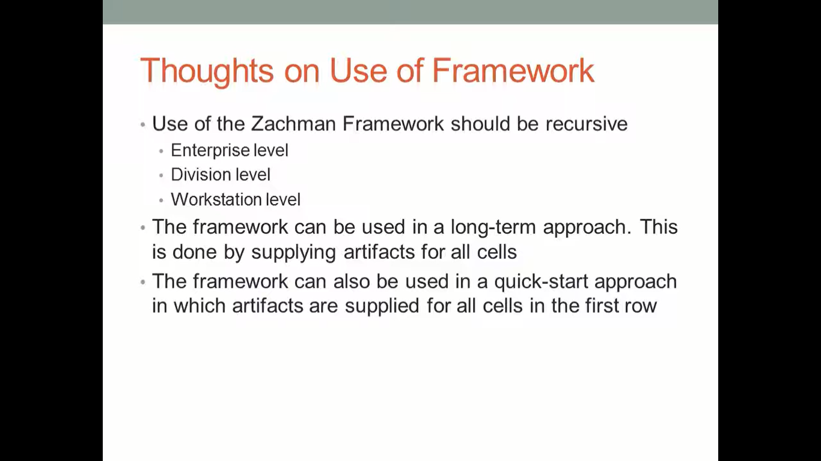

Slide 13
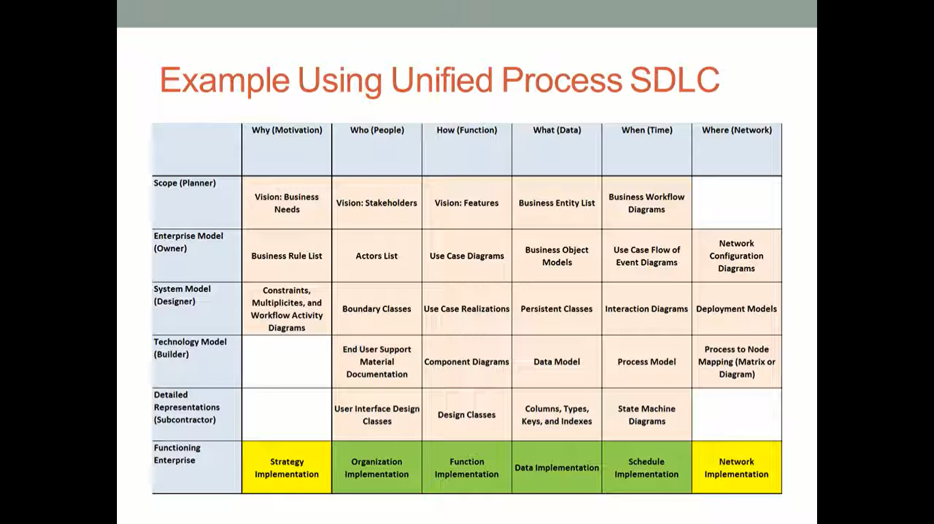

Slide 14
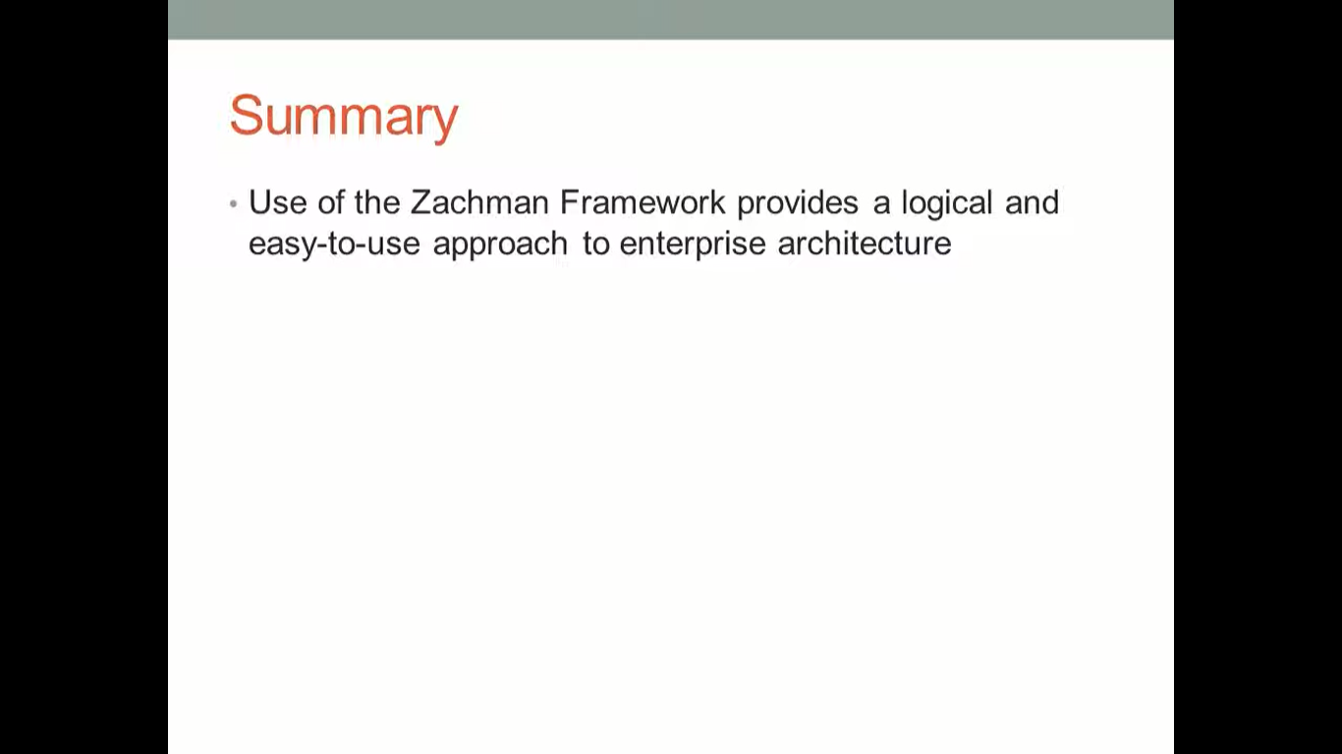


Slide 15
E-Governance Framework
E-governance is the use of digital technologies to improve the efficiency, transparency, and accessibility of government services and processes. An e-governance framework refers to the set of policies, standards, and infrastructure that support the implementation and operation of e-governance initiatives.
There are many different elements that can be included in an e-governance framework, depending on the specific needs and goals of the government or organization. Some common components might include:

Slide 16
Digital infrastructure: This includes the hardware, software, and network infrastructure needed to support e-governance initiatives, such as servers, databases, and communication channels.
Policies and standards: E-governance frameworks often include guidelines and standards for the development, deployment, and operation of e-governance systems. This might include technical standards for interoperability and security, as well as policies for data protection and privacy.
Services and applications: E-governance frameworks often include a range of online services and applications that allow citizens and businesses to interact with government agencies and access information and services. These might include portals for submitting tax returns, applying for licenses and permits, or accessing public records.
Training and support: E-governance frameworks often include provisions for training and support to help citizens and businesses learn how to use e-governance systems and services.

Slide 17
Here is an example of an e-governance framework:
e-governance framework that aims to make all government services accessible to the public through a single portal. It includes a range of initiatives and programs, including the development of a nationwide network of Common Service Centers (CSCs) where citizens can access government services and information, and the implementation of a variety of online services and applications.
You can find more information about the National e-Governance Plan at the following website:
https://mocit.gov.np/application/resources/admin/uploads/source/EConsultation/EN%20Digital%20Nepal%20Framework%20V8.4%2015%20July%20%202019.pdf

